Slide 1
Battle of Neighborhood for New Restaurant

Slide 2
Selecting location for a new venture: Basic yet Critical decision
What type of restaurants the particular neighborhood is already having
Should the new venture follow any of the existing restaurant type (i.e. Mexican, Italian etc.) which is thriving in the neighborhood or should it be a new concept or cuisine
What are the other amenities the neighborhood is having; which may decide the type of restaurant like if a gym is nearby, more likely younger crowd is expected; which may incline to open a café rather than a proper diner place

Slide 3
Data acquisition and cleaning
Toronto neighborhood data is extracted from Wikipedia site
https://en.wikipedia.org/wiki/List_of_postal_codes_of_Canada:_M
Raw data set contains 288 neighborhood information
Raw data set is cleansed through removing neighborhood not having borough information, grouping neighborhood of same postal code into single row, replacing neighborhood name with borough where neighborhood is missing
Cleanse data set contains 103 neighborhood information
The data set is enriched with latitude and longitude information and Location data is fetched through Foursquare API
https://foursquare.com/

Slide 4
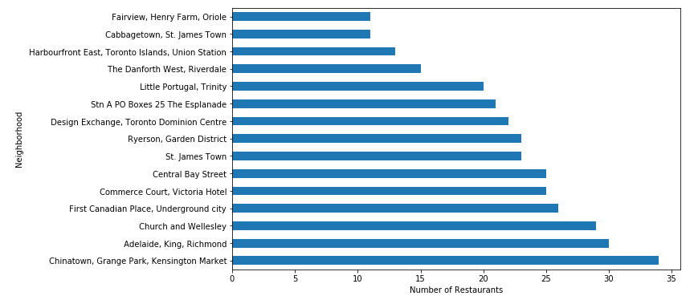
Data Analysis – Restaurant Savvy Neighborhoods
Simple logic: A place where restaurant business is already successful, can easily accommodate another new one
Top 15 Restaurant Savvy Neighborhoods

Slide 5
Data Analysis – Neighborhood having crucial venues
Restaurant can be built around other crucial venues to ensure more footfall in the neighborhood thus in restaurant
Crucial venue includes-
Hospital
Gym
Historic Site
Airport
Bus
School
Hotel/Motel
Shopping Mall
Theater
Metro
Bar/Pub

Slide 6
Data Analysis – Neighborhood having crucial venues
Neighborhood | Venue Count
Design Exchange, Toronto Dominion Centre | 20
Commerce Court, Victoria Hotel | 20
First Canadian Place, Underground city | 17
Stn A PO Boxes 25 The Esplanade | 16
Little Portugal, Trinity | 16
Church and Wellesley | 15
St. James Town | 15
Adelaide, King, Richmond | 14
Harbourfront East, Toronto Islands, Union Station | 14
Ryerson, Garden District | 12
Chinatown, Grange Park, Kensington Market | 11
CN Tower, Bathurst Quay, Island airport, Harbourfront West, King and Spadina, Railway Lands, South Niagara | 11
Berczy Park | 9
Harbourfront, Regent Park | 8
Fairview, Henry Farm, Oriole | 7

Slide 7
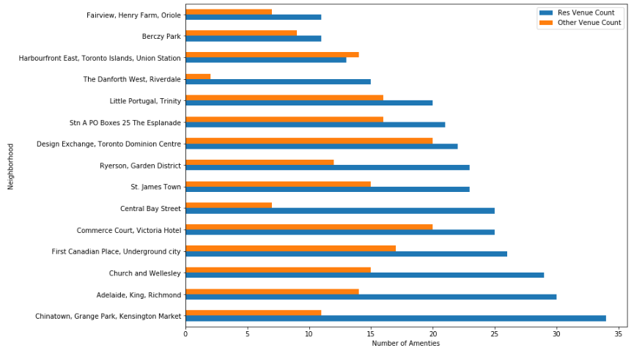
Data Analysis – Restaurant vs Other Venues
Comparative study to see the relationship between restaurant vs other venues in a neighborhood

Slide 8
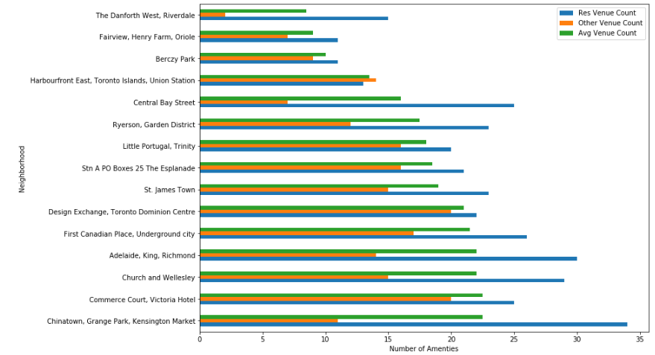
Data Analysis – Restaurant vs Other Venues
Average venue count considering the no of restaurant and other venues to determine neighborhood value index

Slide 9
Conclusion
Considering all the primary factors i.e. Restaurant, Other Venue and their average below 3 neighborhoods seem to be the ideal choice for new restaurant
Neighborhood | Restaurant Count | Other Venue Count | Avg Venue Count
Commerce Court, Victoria Hotel | 25 | 20 | 22.5
Design Exchange, Toronto Dominion Centre | 22 | 20 | 21
Harbourfront East, Toronto Islands, Union Station | 13 | 14 | 13.5

Slide 10
Limitations of the Analysis
Other key location selection criteria for a new restaurant could be, which we have missed in our analysis due to data constraint
life style of the neighborhood (i.e. Rich¸ Middle class or upper middle class)
likely age group of the neighborhood (i.e. Teen¸ Middle age)
Real Estate status of the neighborhood
Transportation for raw materials etc.

